Slide 1
Capstone Project: restaurants in Metro Manila (using Zomato Kaggle datasets)

Slide 2
Introduction
In this project, we would like to know what is the best possible place for a restaurant in Metro Manila. It is officially known as National Capital Region (NCR) and is the capital of the Philippines.
There are a whopping 21,017 hotel and restaurant establishments from a 2000 census done by the Philippine government. NCR is comprised of 897 barangays. These are grouped into six congressional districts. For the purpose of this project, we will group the restaurants by district.
So as part of this, we will list and visualize all major parts of NCR.

Slide 3
Objectives
Question that can be asked:
What is the best location in NCR for a restaurant?
Which area have a large number of restaurants?
Which of the areas have the least number of restaurants?
Which is the best place to stay if I prefer Korean food?
What places have high rating of restaurants?

Slide 4
Target
Entrepreneurs who are interested in finding the best spot to open a restaurant.
People who would like to know which locality is best to eat a specific food (ie. Korean).
People who would like to eat in a restaurant based on the rating.

Slide 5
Data
NCR restaurant data that contains list of localities, hotel name, rating along with their latitude and longitude.
Data source: Zomato Kaggle Dataset: “https://www.kaggle.com/jeppbautista/zomato-dataset-for-metro-manila-restaurants?select=location.csv”
Description: This dataset contains the required information. We will use this dataset to explore various locality of NCR.
2. Nearby places in each locality of NCR.
Data source: FourSquare API: “https://developer.foursquare.com/”
Description: By using this API we will get all the venues in each neighborhood

Slide 6
Approach
Collect the Metro Manila data from Zomato Kaggle dataset.
Using FourSquare API I will find all venues for each neighborhood.
Filter out all venues that are nearby by locality.
Using aggregate rating for each restaurant to find the best places.
Visualize the ranking of neighborhoods using Folium library.

Slide 7
results

Slide 8
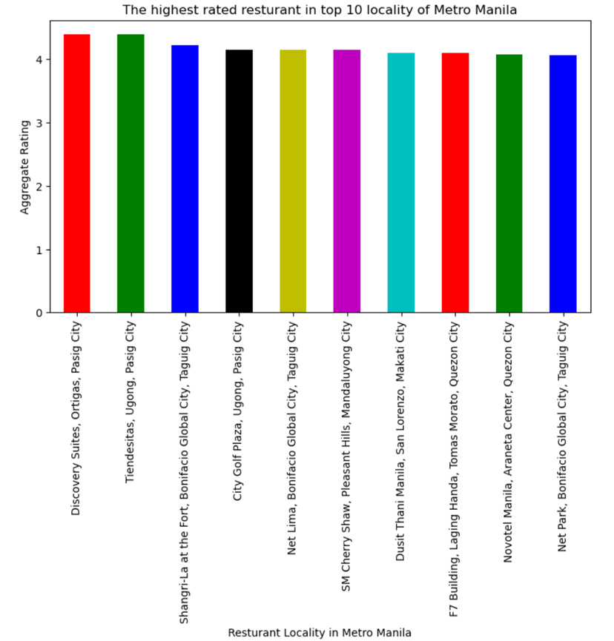

Slide 9
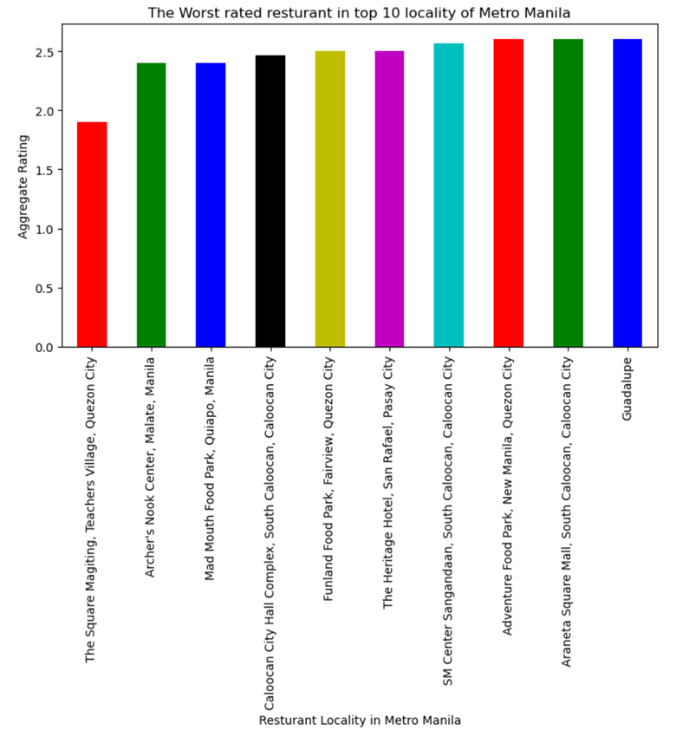

Slide 10
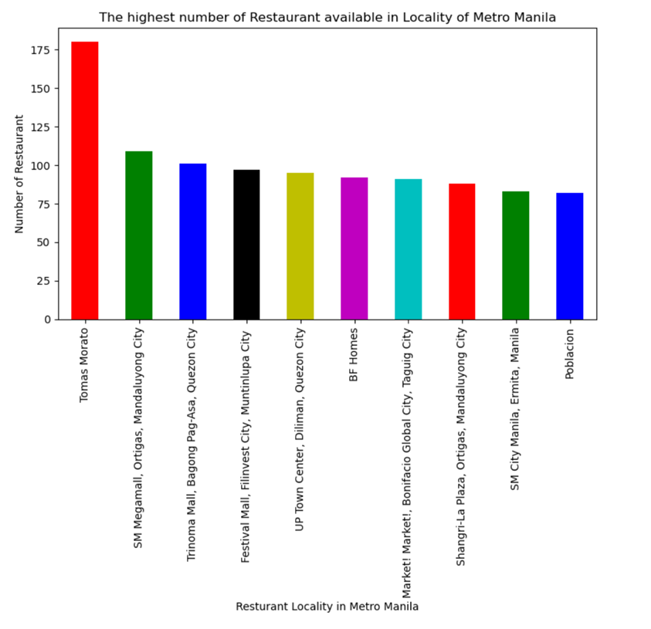

Slide 11
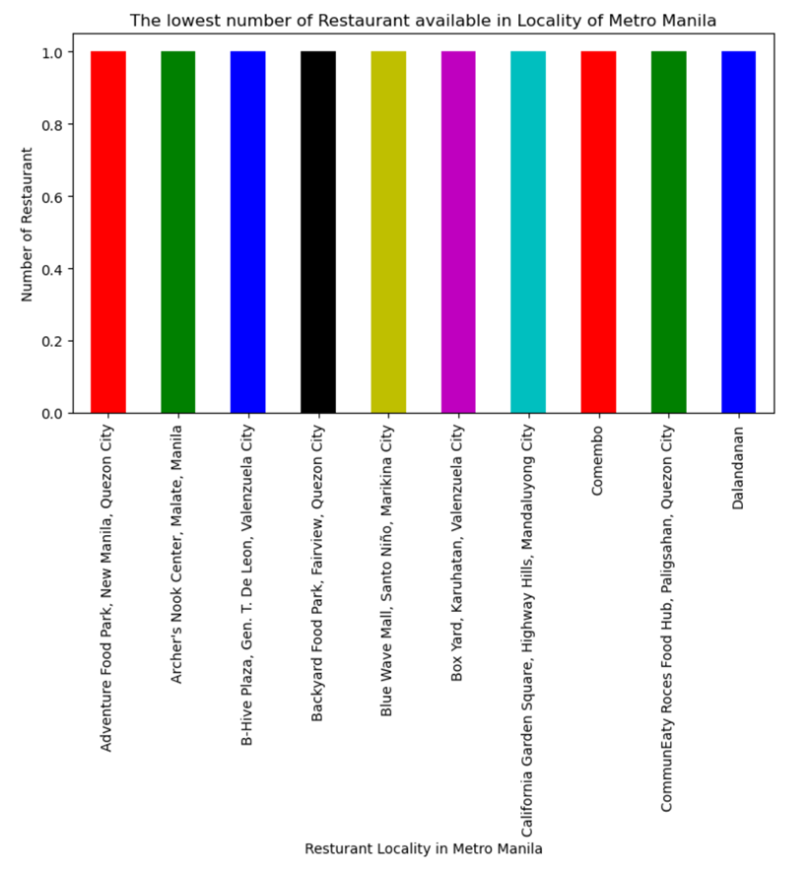

Slide 12
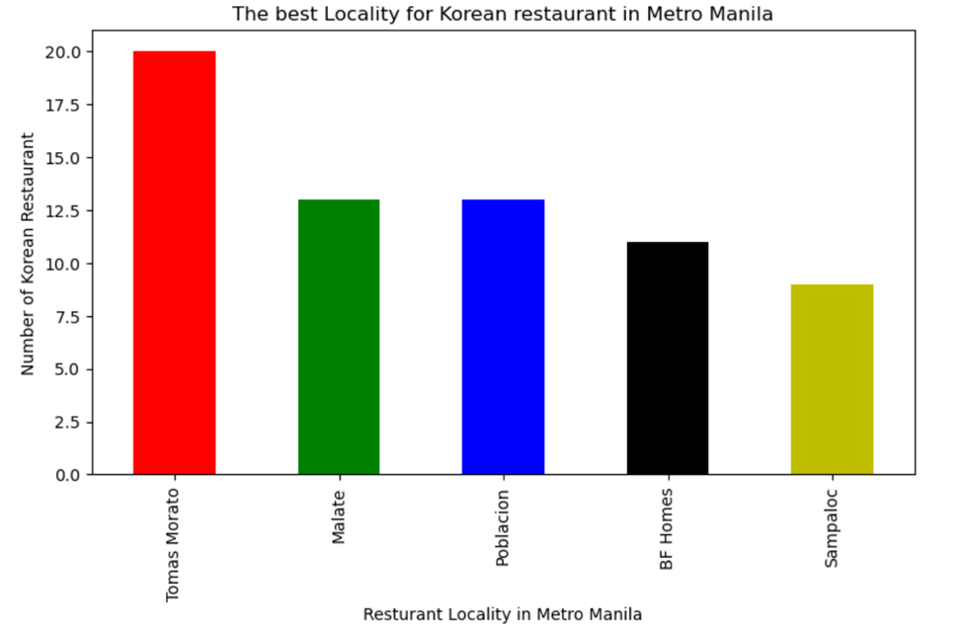

Slide 13
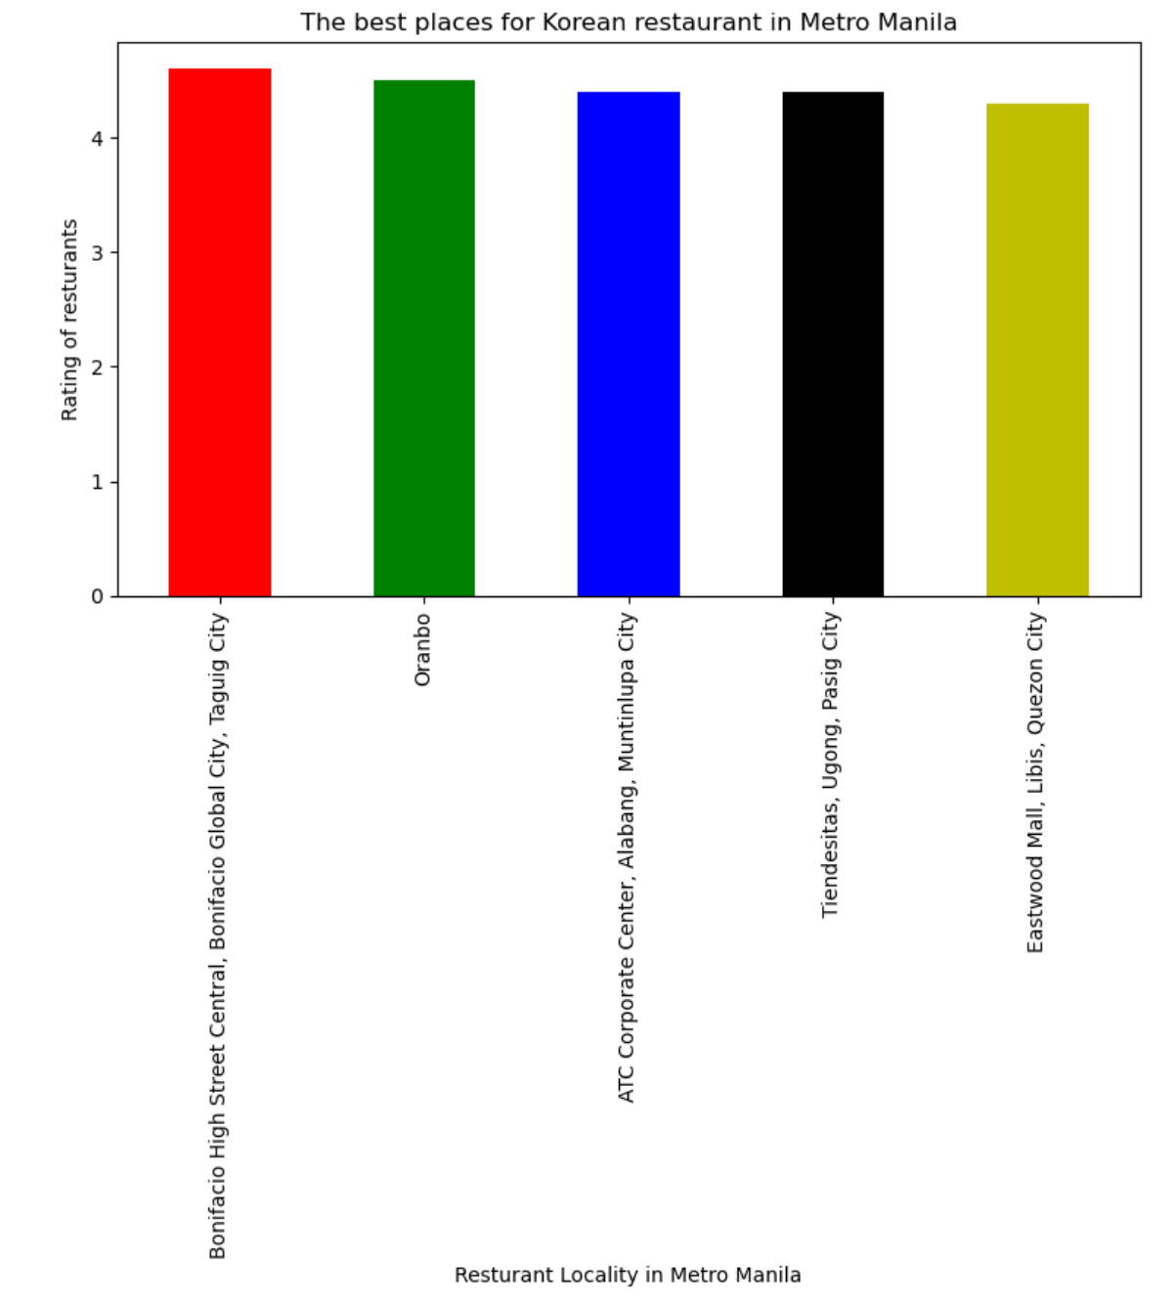

Slide 14
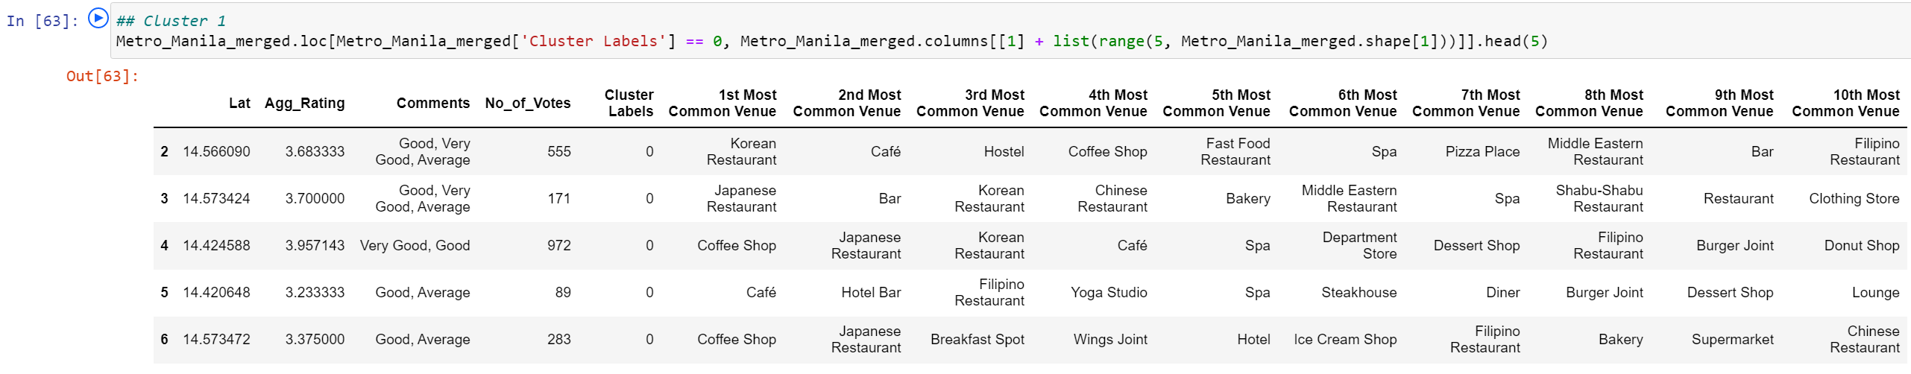
Cluster 1: Coffee Shops are the most recommended venues in Cluster 1 with 99 available. There are also 286 localities.

Slide 15
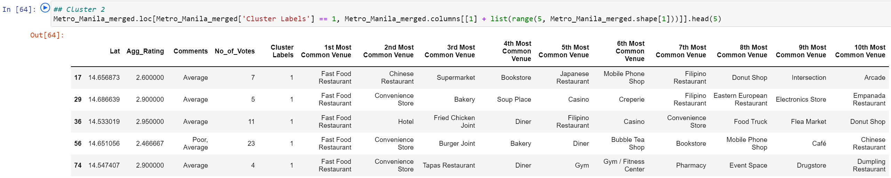
Cluster 2: Fast food restaurants are the most recommended here with 33 available. There are also 42 localities in Cluster 2.

Slide 16
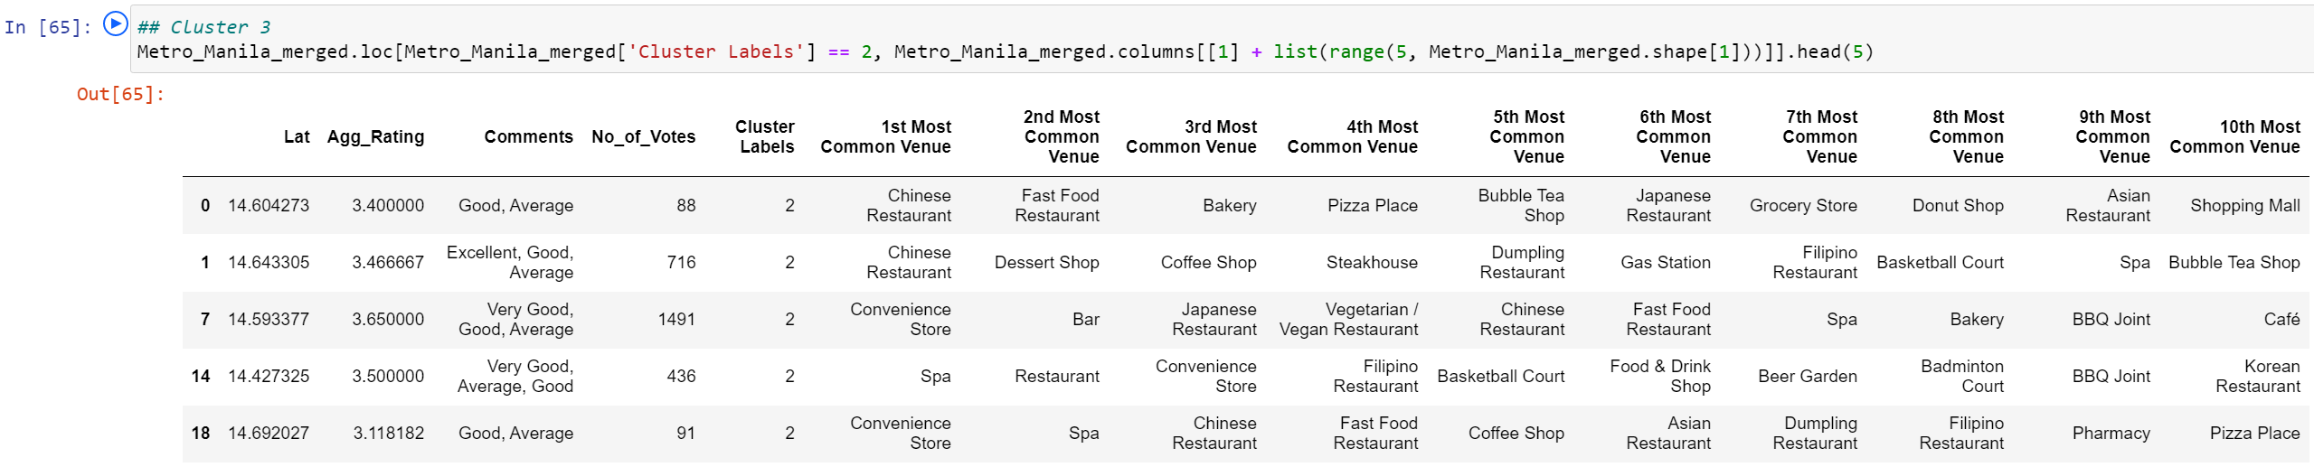
Cluster 3: Convenience stores are abundant here with 29 available. It is followed by 21 fast-food restaurants and 19 Chinese restaurants. There are 118 localities in Cluster 3.

Slide 17
Discussion
Looking at the unique elements in the ‘1st Most Common Venue’ column of each cluster, it can be seen that Cluster 1 has the greatest number of Korean restaurants with 9 available. Cluster 1 is also where coffee shops/cafes are most abundant. If a person is not demanding of the type of cuisine they eat, places in Cluster 1 would be best. It has Filipino, Japanese, Chinese, Korean, Italian, and Seafood restaurants. Cluster 2 would also be viable if they do not mind fast food restaurants instead. Cluster 3 also has a lot of fast-food restaurants, but unlike Cluster 2 where it the only viable option is a Chinese restaurant, Cluster 2 has more other options. It has a Filipino, Chinese, Thai, Korean, Asian, Steakhouse, and Italian restaurants.

Slide 18
conclusion
To iterate, the best rated restaurants in Metro Manila are both in Pasig City, particularly in Ortigas and Ugong. The worst rated restaurant is in Teachers Village, Quezon City. Tomas Morato has the greatest number of restaurants and also has the greatest number of Korean restaurants. And Bonifacio Global City in Taguig City has the best rated Korean restaurant.
Foursquare data and K-means algorithm, alongside with folium mapping tools can be powerful tools helping people narrow down the places that caters a restaurant according to their tastes. With many options to choose from a little help from a data scientist can really make the process much smoother.

